Slide 1
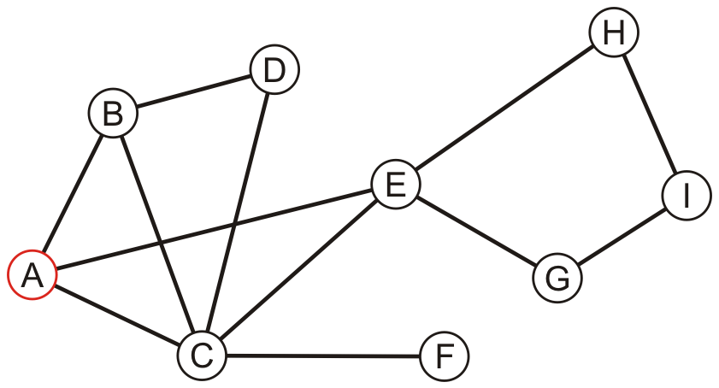
Graph
Reading: Chapters 14
Data Structures and Algorithms in Java

Slide 2
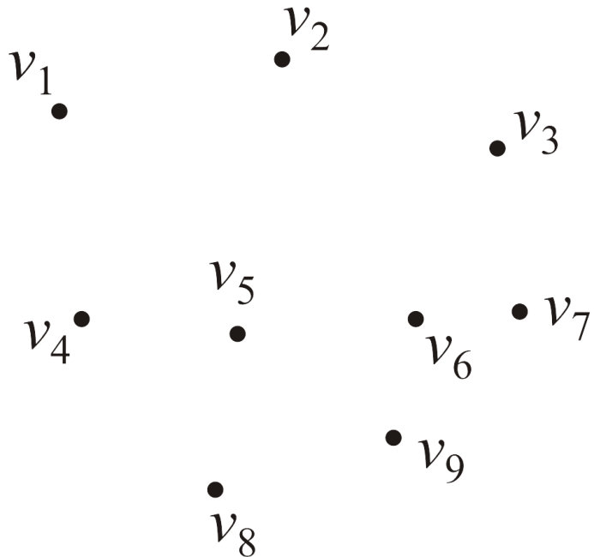
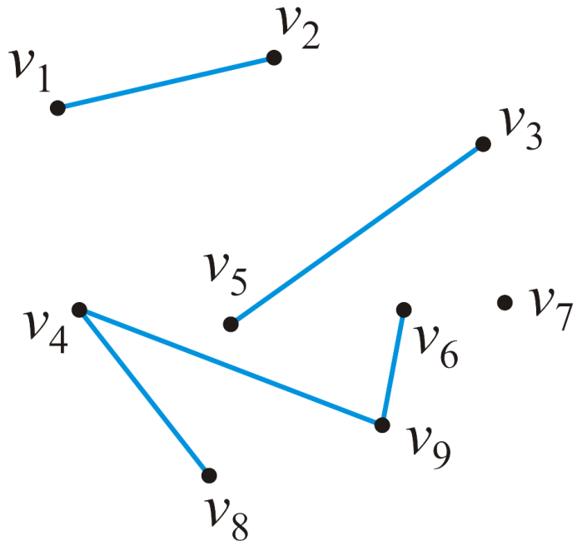
Introduction To Graph
Graph is a structure that consists of disjoint nodes connected by links.
Nodes called vertices
Links called edges
Formally, a graph G is a pair (V, E) where
V is a set of nodes, called vertices
V = {v₁, v₂, ..., v_{n}}
The number of vertices is denoted by |V| = n
E is a collection of pairs of vertices, called edges or links
Edges can be directed or undirected.
The pair {v_{j} , v_{k}} indicates that both vertex v_{j} is adjacent to vertex v_{k} and vertex v_{k} is adjacent to vertex v_{j}
The maximum number of edges in an undirected graph is

Slide 3
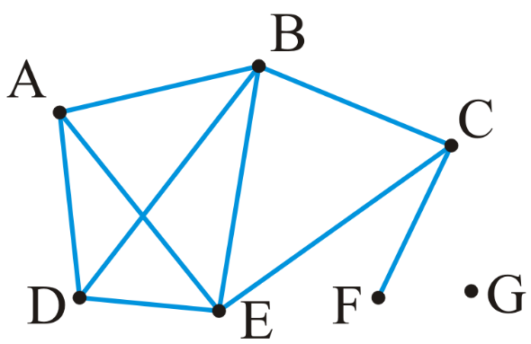
Graph Examples
G = (V, E), where
V = {1, 2, 3, 4, 5}
|V| = 5
E = {(1, 2), (2, 3), (3, 4), (4, 5), (1, 5), (3, 5), (2, 4)}
|E| = 7
Then the graph looks like:
edges
1
2
Vertices
4
3
5
V = {A, B, C, D, E, F, G}
|V| = 7
E = {{A, B}, {A, D}, {A, E}, {B, C}, {B, D}, {B, E}, {C, E}, {C, F}, {D, E}}
|E| = 9
Then the graph looks like:

Slide 4
Graph Applications
Graph can be used to represent a network of relations among objects/concepts.
Transportation networks
Highway network
Flight network
Computer networks
Local area network
Internet
Databases
Entity-relationship
Electronic circuits
Etc.

Slide 5
Graph Applications-Example
Transportation networks: Highway network
A vertex represents a city code and store the city’s name
An edge represents a road between two cities and stores the mileage of the road
Edges can be given a weight: can represent the distance, the time or the cost to travel from one vertex to another.
30
Hermel
100
Baalbek
Qbayat
80
105
30
90
Nabatieh
Ehden
35
60
Zahleh
Jezzine
40
30
40
30
Tripoli
90
50
20
Tyre
70
Beirut
40
Saida
35

Slide 6
Graph Applications-Example
Transportation networks: Flight network
A vertex represents an airport name
An edge represents a flight route between two cities and stores the mileage of the route
6000
NewYork
6500
Paris
475
500
3000
6000
2800
5700
Montreal
Beirut

Slide 7
Graph Applications-Example
Internet
A vertex represents a router
An edge represents the route data will travel from computer source to a computer destination
R2
R5
Computer a
Computer 1
Computer b
R1
R4
R8
R6
Computer 2
Computer c
Computer 3
R3
R7

Slide 8

Degree of a vertex
The degree of a vertex is defined as the number of adjacent vertices
degree(A) = degree(D) = degree(C) = 3
degree(B) = degree(E) = 4
degree(F) = 1 degree(G) = 0
Those vertices adjacent to a given vertex are its neighbors

Slide 9
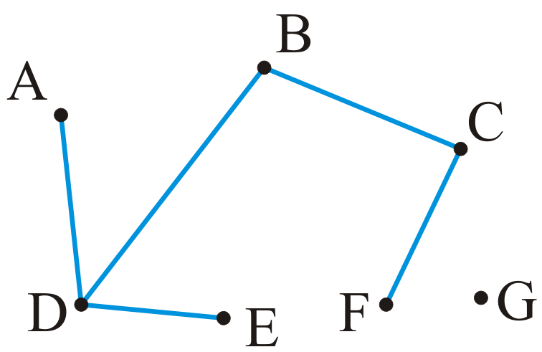

Sub-graphs
A sub-graph of a graph a subset of the vertices and a subset of the edges that connected the subset of vertices in the original graph
A spanning subgraph: contains all the vertices of the graph G

Slide 10
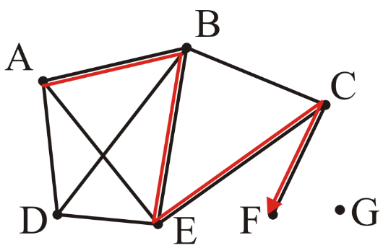
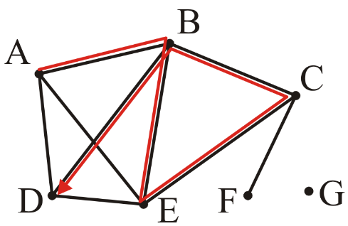
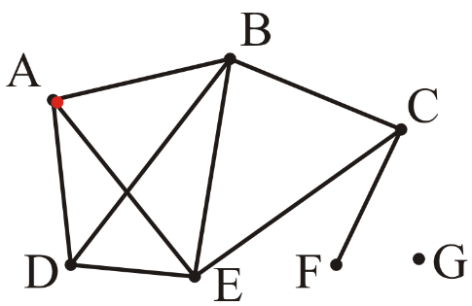
Paths
A path in an undirected graph is an ordered sequence of vertices
(v₀, v₁, v₂, ..., v_{k}) where {v_{j – 1}, v_{j}} is an edge for j = 1, ..., k
Termed a path from v₀ to v_{k}
The length of this path is k
A path of length 4: (A, B, E, C, F)
A path of length 5: (A, B, E, C, B, D)
A trivial path of length 0: (A)

Slide 11
Simple Paths
A simple path has no repetitions (distinct edges) other than perhaps the first and last vertices
P0 = (U, V, W,U)
P1 = (U, W, Y);
P2 = (U, V, X, Y);
P3 = (U, V, W,X, V, W, Y)
P0, P1 and P2 are simple but P3 is not
A simple cycle is a simple path of at least two vertices with the first and last vertices equal
P0 = (U, V, W,U)
Parallel edges: h and i are parallel edges
Self-loop: j is a self-loop
V
a
b
h
j
U
d
X
Z
c
e
i
W
g
f
Y

Slide 12
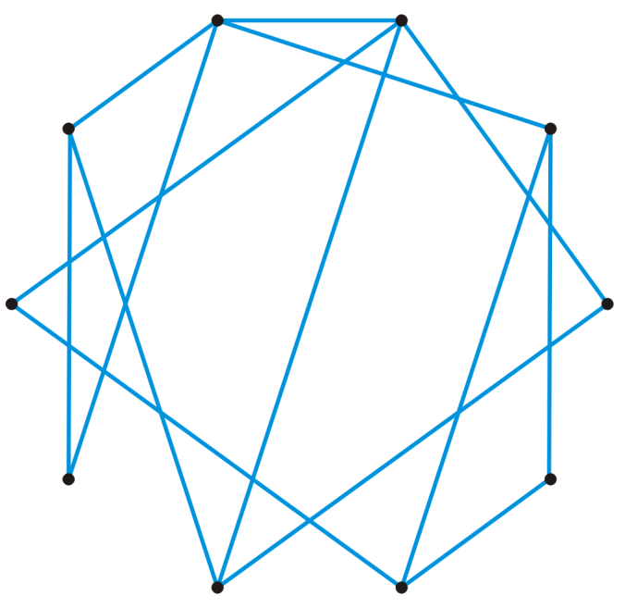
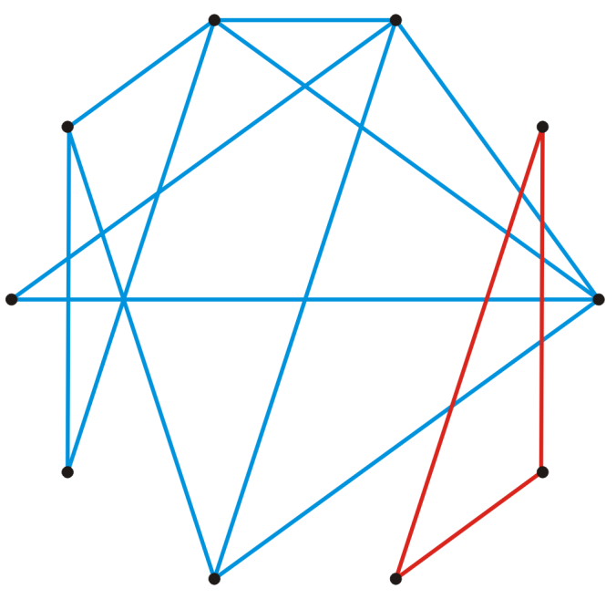
Connectedness
Two vertices v_{i}, v_{j} are said to be connected if there exists a path from v_{i} to v_{j}
A graph is connected if there exists a path between any two vertices
A connected graph
An unconnected graph

Slide 13
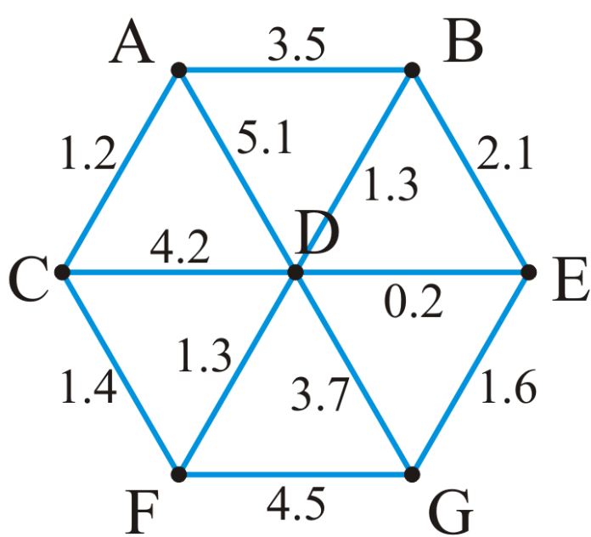
Weighted graphs
A weight may be associated with each edge in a graph
This could represent distance, energy consumption, cost, etc.
Such a graph is called a weighted graph
Pictorially, we will represent weights by numbers next to the edge
The length of a path within a weighted graph is the sum of all of the edges which make up the path
The length of the path (A, D, G) in the following graph is 5.1 + 3.7 = 8.8

Slide 14
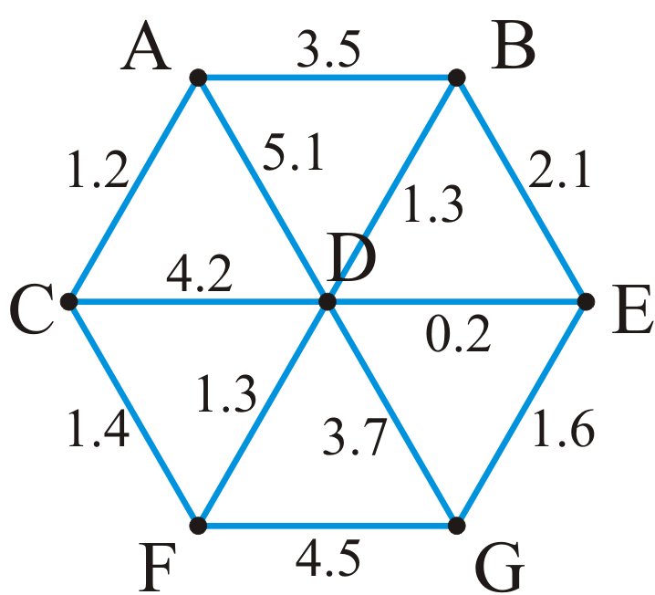
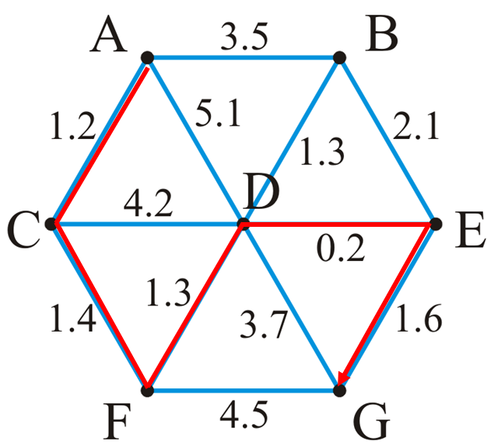
Weighted graphs
Different paths may have different weights
Another path is (A, C, F, G) with length
1.2 + 1.4 + 4.5 = 7.1
Problem:
find the shortest path between two vertices
Here, the shortest path from A to H is (A, C, F, D, E, G) with length 5.7

Slide 15
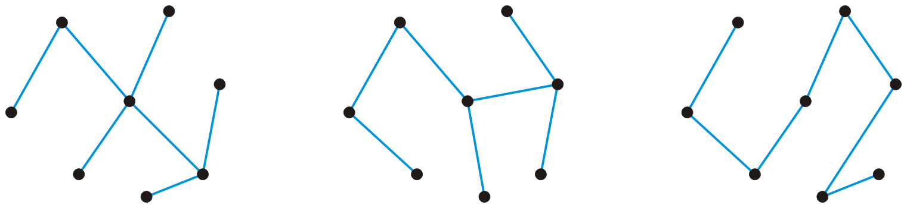
Trees
A graph is a tree if it is connected and there is a unique path between any two vertices
Three trees on the same eight vertices
Consequences:
The number of edges is |E| = |V| – 1
The graph is acyclic, that is, it does not contain any cycles
Adding one more edge must create a cycle
Removing any one edge creates two disjoint non-empty sub-graphs

Slide 16
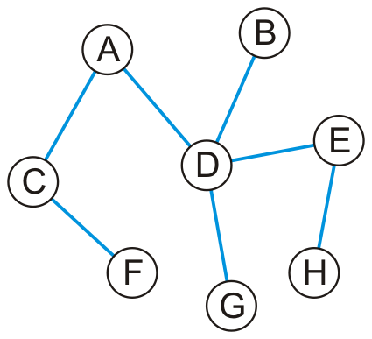
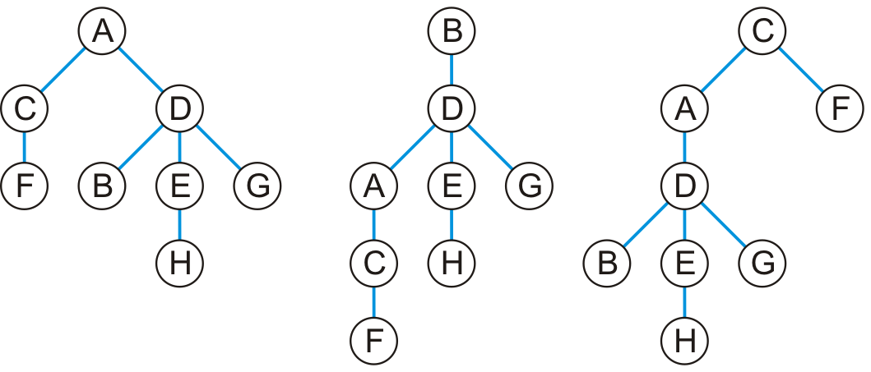
Trees
Any tree can be converted into a rooted tree by:
Choosing any vertex to be the root
Defining its neighboring vertices as its children
and then recursively defining:
All neighboring vertices other than that one designated its parent are now defined to be that vertices children
Given this tree, here are three rooted trees associated with it

Slide 17
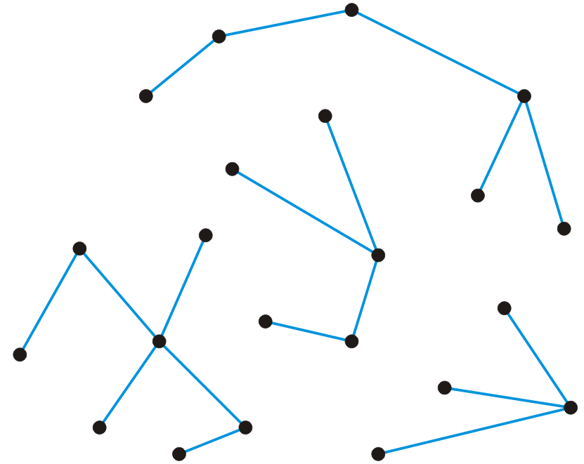
Forests
A forest is any graph that has no cycles
A tree is a connected forest: connected graph without cycles.
The connected components of a forest are trees.
Consequences:
The number of edges is |E| < |V|
The number of trees is |V| – |E|
Removing any one edge adds one more tree to the forest
Here is a forest with 22 vertices and 18 edges
There are four trees

Slide 18
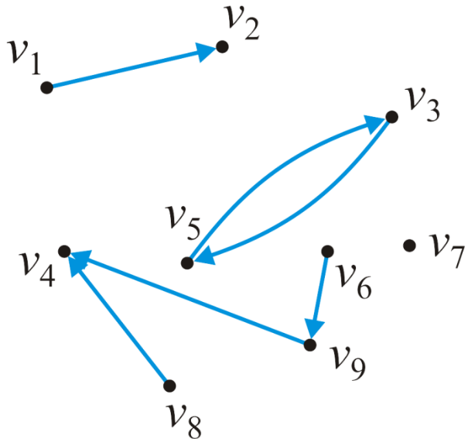
Directed graphs
In a directed graph, the edges on a graph are be associated with a direction
Edges are ordered pairs (v_{j}, v_{k}) denoting a connection from v_{j} to v_{k}
The edge (v_{j}, v_{k}) is different from the edge (v_{k}, v_{j})
Streets are directed graphs:
In most cases, you can go two ways unless it is a one-way street
Given our graph of nine vertices V = {v₁, v₂, …v₉}
These six pairs (v_{j} , v_{k}) are directed edges
E = {(v₁, v₂), (v₃, v₅), (v₅, v₃), (v₆, v₉), (v₈, v₄), (v₉, v₄)}
The maximum number of directed edges in a directed graph is

Slide 19
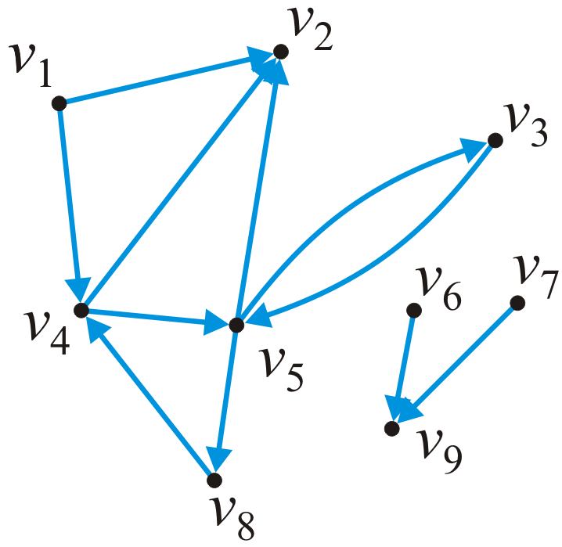
In and out degrees
The degree of a vertex must be modified to consider both cases:
The out-degree of a vertex is the number of vertices which are adjacent to the given vertex
The in-degree of a vertex is the number of vertices which this vertex is adjacent to
In this graph:
in_degree(v₁) = 0 out_degree(v₁) = 2
in_degree(v₅) = 2 out_degree(v₅) = 3

Slide 20

Paths
A path in a directed graph is an ordered sequence of vertices
(v₀, v₁, v₂, ..., v_{k}) where (v_{j – 1}, v_{j}) is an edge for j = 1, ..., k
A path of length 5 in this graph is (v₁, v₄, v₅, v₃, v₅, v₂)
A simple cycle of length 3 is (v₈, v₄, v₅, v₈)

Slide 21

Connectedness
Two vertices v_{j}, v_{k} are said to be connected if there exists a path from v_{j} to v_{k}
A graph is strongly connected if there exists a directed path between any two vertices
The sub-graph {v₃, v₄, v₅, v₈} is strongly connected
A graph is weakly connected there exists a path between any two vertices that ignores the direction
The sub-graph {v₁, v₂, v₃, v₄, v₅, v₈} is weakly connected

Slide 22
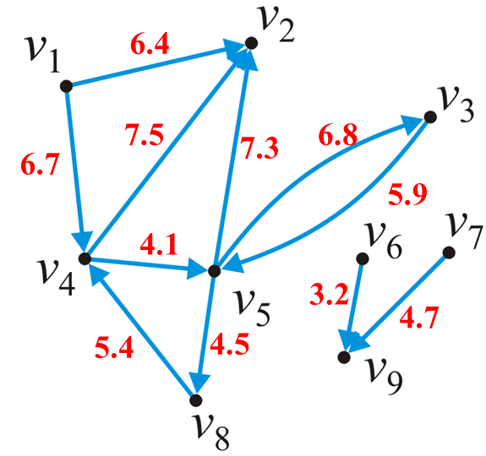
Weighted directed graphs
In a weighted directed graphs, each edge is associated with a value
Unlike weighted undirected graphs, if both (v_{j}, v_{k}) and (v_{j}, v_{k}) are edges, it is not required that they have the same weight

Slide 23
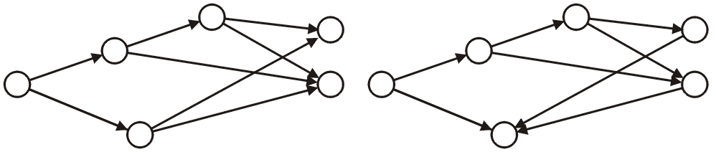
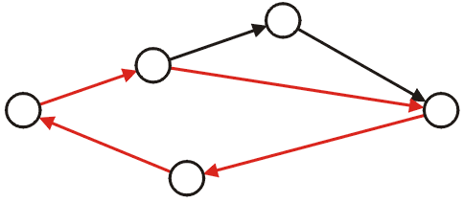
Directed acyclic graphs
A directed acyclic graph is a directed graph which has no cycles
These are commonly referred to as DAGs
They are graphical representations of partial orders on a finite number of elements
These two are DAGs:
This directed graph is not acyclic:

Slide 24
Graph Representation
Vertex represents real–world object.
Object must be described using data items.
For example, If an object represents a city in an airline route simulation, it may need to store the name of the city, its altitude, its location, etc.
For simplicity, in our example a vertex stores only a letter (like A) and a flag to use in search algorithms.
Vertices can be placed in an array, vector, a list or other data structure
Pseudo code
class Vertex {
public char label; // label (e.g. 'A')
public boolean wasVisited;
public Vertex(char lab) { // constructor
label = lab;
wasVisited = false;
}
}
E
A
B
C
D

Slide 25
Graph Representation
Each vertex can be connected to an arbitrary number of other vertices.
A is connected to 4 vertices while E is connected to only two
Two methods are used to represent edges in a graph
Adjacency Matrix
Adjacency List
E
A
B
C
D

Slide 26
Graph Representation: Adjacency matrix (undirected graph)
Two dimensional array
Vertices are used as headings for both rows and columns
Matrix entry (j, k) is set to true if there is an edge (v_{j}, v_{k})
1 indicates presence of an edge between two vertices (True)
0 indicates absence of an edge (False)
Since the graph is undirected, if an edge goes from A to B, then the same edge goes from B to A
If a graph has N vertices, the adjacency matrix is NxN array
 | A | B | C | D | E
A | 0 | 1 | 1 | 1 | 1
B | 1 | 0 | 0 | 1 | 1
C | 1 | 0 | 0 | 1 | 0
D | 1 | 1 | 1 | 0 | 0
E | 1 | 1 | 0 | 0 | 0
E
A
B
C
D

Slide 27
Graph Representation: Adjacency List (undirected graph)
Array of linked lists, one list for each vertex.
List for vertex A contains one node for each vertex that is adjacent to A
A has four adjacent vertices, B and D have three each, C and E have two each
A{B, C, D, E}; B{A, D, E}; C{A, D}; D{A, B, C}; E{A, B}
A
B
C
D
E
null
B
A
D
E
null
E
C
A
D
null
A
B
D
A
B
C
null
C
D
E
A
B
null

Slide 28
Graph Representation: Adjacency matrix (directed graph)
Two dimensional array
Vertices are used as headings for both rows and columns
Elements indicate whether an edge is present between two vertices
1 indicates presence of an edge between two vertices
0 indicates absence of an edge
Boolean can be used instead (true / false values)
Since the graph is directed, if an edge goes from A to B, it does not mean the same edge goes from B to A. A different edge can be added when necessary to go from B to A
If a graph has N vertices, the adjacency matrix is NxN array
E
A
B
C
D
 | A | B | C | D | E
A | 0 | 1 | 0 | 0 | 0
B | 1 | 0 | 0 | 1 | 0
C | 1 | 0 | 0 | 0 | 0
D | 1 | 0 | 1 | 0 | 0
E | 1 | 1 | 0 | 0 | 0

Slide 29
Graph Implementation-Adjacency Matrix
PseudoCode (not a complete code)
class Graph {
private int MAX_VERTS = 20;
private Vertex vertexList[]; // list of vertices
private int adjMat[][]; // adjacency matrix private
int nVerts; // current number of vertices private
public Graph() { // constructor
vertexList = Vertex[MAX_VERTS];
adjMat = int[MAX_VERTS][MAX_VERTS];
nVerts = 0;
for (int j = 0; j < MAX_VERTS; j++) // set adjacency matrix to 0
for(int k = 0; k < MAX_VERTS; k++)
adjMat[j][k] = 0;
}
public void addVertex(char lab) {
vertexList[nVerts++] = Vertex(lab);
}
public void addEdge(int start, int end) { //vertices are identified by their
// index number in vertexList
adjMat[start][end] = 1;
adjMat[end][start] = 1; //this line should be
//removed if the graph is directed
}
public void displayVertex(int v) {
System.out.print(vertexList[v].label);
}
}

Slide 30
Graph Implementation-Adjacency Matrix
These two methods can replace addEdge.
Vertices are identified by their index number in vertexList, so we will have to keep track of the index number of the vertex.
public void addEdge(char start, char end) {
int I = index(start);
if (i<0) return;
int j = index(end);
if (j<0) return;
adjMat[i][j] = 1;
adjMat[j][i] = 1; //this line to be removed if the graph is directed
}
public int index(char v) {
for (int i = 0; i < MAX_VERTS; i++)
if (vertexList[i].label==v)
return i;
return -1;
}

